Slide 1
AgriPulse Synchronized Growth, Sustainable Tomorrow

Slide 2


AgriPulse Synchronized Growth, Sustainable Tomorrow
Mentor : Mr. Dipayan Sarkar
Team Members:
Tushar Bhat
Aastha Rathi
Ishan Mehta
Isheeta sharma
Mohit Bhatia
Palak tyagi
Ankit hooda
Batch : PGP-DSE Gurgaon, 2023
Domain of project : Agriculture

Slide 3
Problem Definition.
In the modern agricultural landscape, a critical puzzle confronts farmers and scientists alike, predicting crop yield accurately. This metric, pivotal for economic planning, resource allocation, and global food security, hinges on a web of complex and ever-changing variables.
The pressing issue at hand is the absence of a sophisticated approach to optimize crop selection and timing in the Indian agricultural sector, resulting in suboptimal yields and economic inefficiencies. This not only affects the livelihoods of farmers and merchants but also poses risks to national food security and economic stability.
This project is a catalyst for transforming Indian agriculture. By developing a unified toolkit, we aim to accurately predict crop yields, optimize crop rotations for improved soil health, and streamline seasonal planning.
Our solution focuses on empowering stakeholders with actionable insights, fostering informed decision-making, resource efficiency, and the adoption of sustainable practices. This initiative seeks to redefine India's agricultural landscape, promoting resilience, efficiency, and long-term economic prosperity.

Slide 4
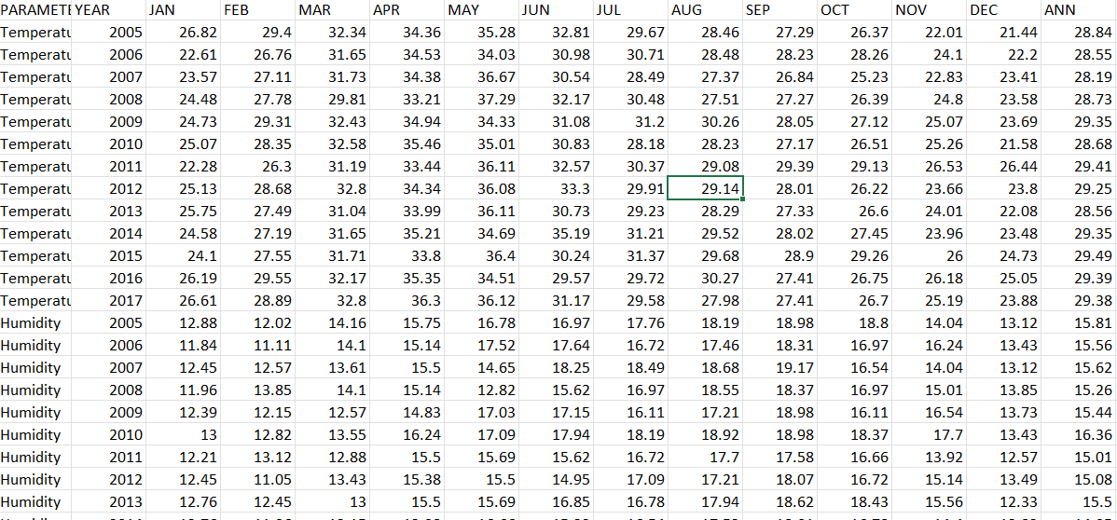
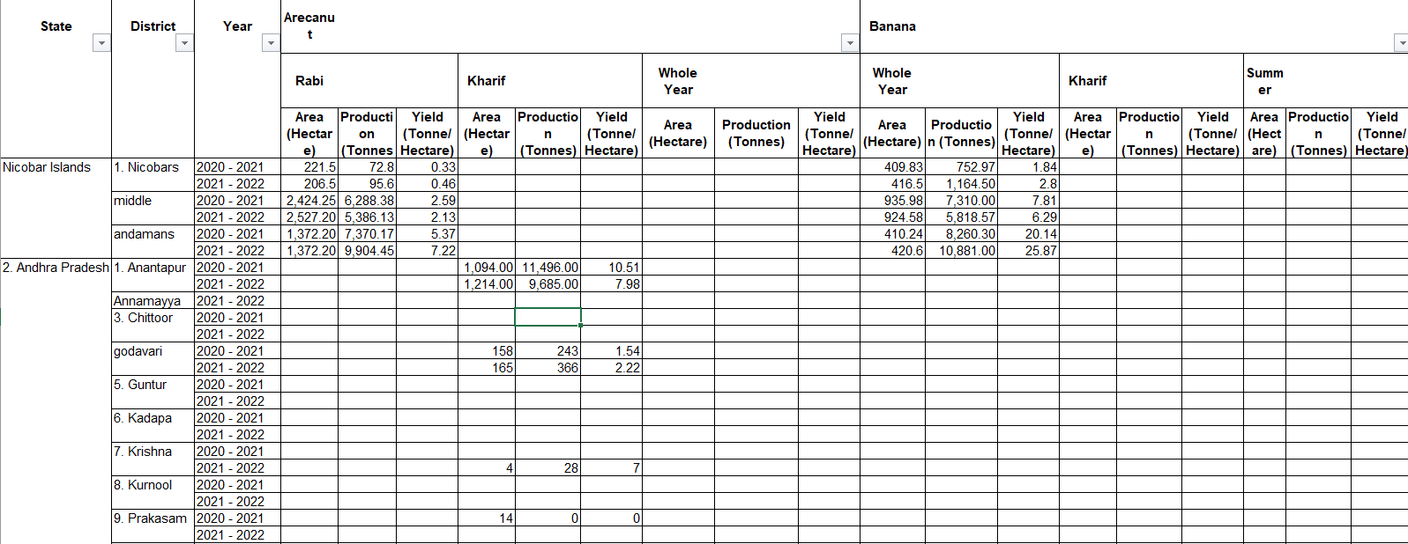
Data Collection
Initial features :
State, District, Crop, Season,Year, Area, Production, yield
Timeline(2005 - 2021) was collected from
https://data.desagri.gov.in/website/crops-apy-report-web
After extensive research we found that yield depends on following variables :
Temperature, humidity, rainfall and various soil characteristics
Data for these variables was collected from nasa website.
(state-wise , month- year rainfall)
https://power.larc.nasa.gov/data-access-viewer/

Slide 5
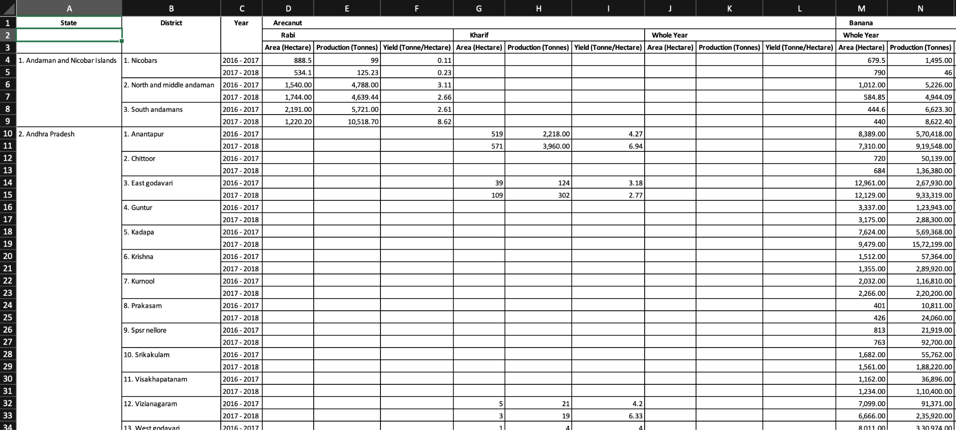
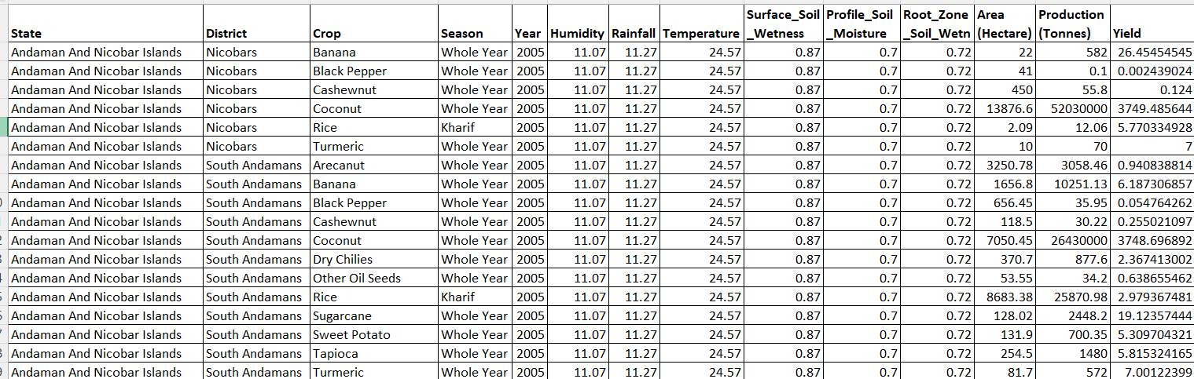
Data Preprocessing
The shape of data was in the horizontal format initially, which was transformed to readable pandas format, using python library openpyxl
Other features, temperature, humidity, rainfall, soil were concatenated with dataset on state-year columns.
To reduce the dimensions further, accumulative effect of each variable was captured season wise.
Before
After

Slide 6
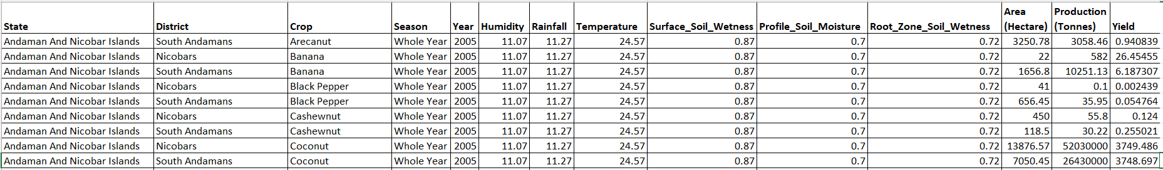
Data set and Variables :
Variable information/Data description
Independent Variables (X):
Crop : Name of the crop
Season : Time of the year when the crop is cultivated
Year : Data for the last 20 years (2001 to 2021)
Humidity : Humidity of the state in grams/kg
Rainfall : Rainfall per state (mm/day)
Temperature : Earth skin temperature in Celsius
Surface_Soil_Wetness : Surface to 5 cm below soil wetness
Profile_Soil_Moisture : Surface to bedrock soil wetness
Root_Zone_Wetness : Surface to 100 cm below soil wetness
Area : Data of the area of land used for production (in Hectare)
Production : Production of crop in Tones
Dependent Variable (Y):
Crop Yield : Data on the total amount of crop cultivated during specific time periods

Slide 7
Exploratory Data Analysis (EDA)
Data had high number of Missing values, which were treated in data preprocessing
Univariate Analysis:
Numerical columns :
Multimodal distribution was observed in case of Humidity, Temperature and Soil
Area, Production and Yield were highly right-skewed with outliers.
Categorical Columns :
Major contributing states are Uttar Pradesh, Karnataka, Madhya Pradesh, Bihar, Tamil Nadu.
Major contributing Crops are Rice, Mazie, GreenGram, Urad, Sesamum
Seasons - Kharif, Rabi, whole year.
Bivariate analysis:
Very High Skewness was observed in all categorical features, suggesting dependency
Time series analysis:
Variables like yield, temperature,soil,rainfall show a time series trend ,which we captured by forecasting using time series based model(ARIMA)
Grouping upon states, districts, crop, year we have created lag features of these predictors to further capture the seasonal variations.
However,there were fluctuations in trend within some group of crops that we will be discussed further.

Slide 8
Algorithms and Solution
Regression Model ( LinearRegression ) - underfitting.
Only 2.4% of variance in yield was explained by independent variables. Prob(f-statistics) suggests that model is statistically significant in explaining some variance in yield.
Jarque-Bera is high, violating the initial assumption for Linear Regression.
The overall findings suggests that, collectively, independent variables are statistically significant predictors of target variable. However, this significance does not necessarily imply a strong or practical predictive power, especially when relation is not linear or is complex.
Decision Based Model ( Decision Tree) - overfitting.
With initial r2_score - 0.97 on train and 0.12 on test data. The algorithm has learned exact patterns, therefore is not generalised.
Very High mean absolute percentage error for both train and test data suggests irregularity in predictions and it is possible that model has learned noise.
Ensemble Model ( Random forest )
Slightly better performance on test data(0.47). Although there are some 'nays' in the data.
Implementing the time series forecasting algorithms(ARIMA) to accurately predict the variables that are changing with time.
Following a thorough exploration of data patterns, we tested several algorithms including Decision Tree, Random Forest, AdaBoost, Gradient Boosting, and XGBoost. This was in response to the limitations of linear models, aiming to uncover non-linear relationships with a spectrum of models. Our objective was to find an optimal balance of precision, clarity, and efficiency, tailored to our dataset distinct features.

Slide 9
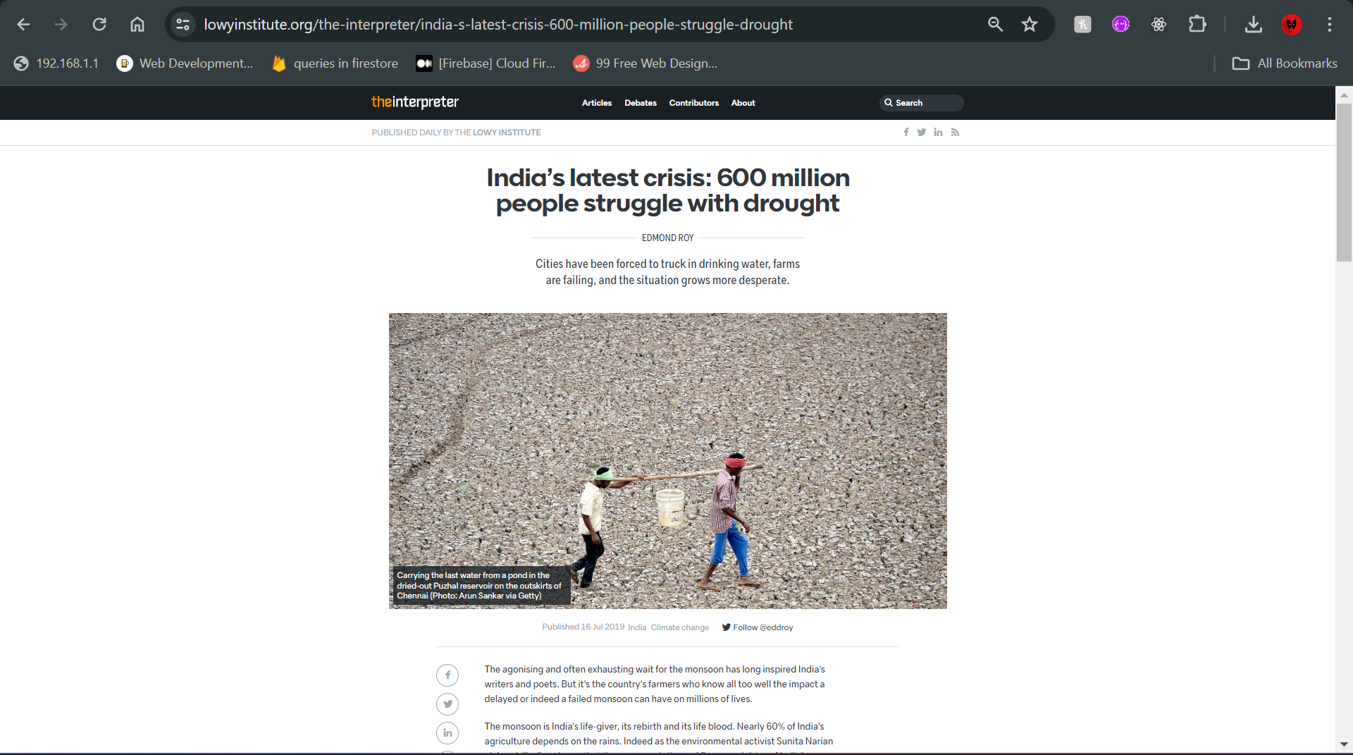
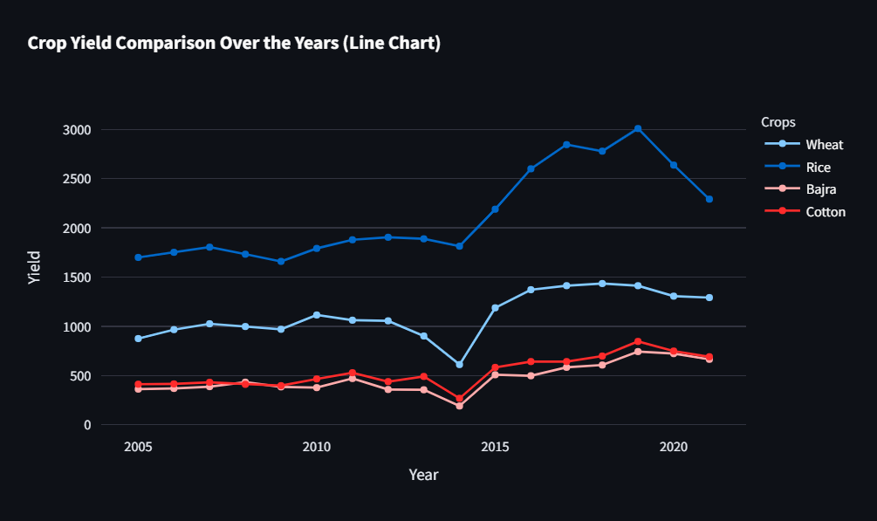
Conclusion
These fluctuations in the trends of various crops during the same time periods, some major fluctuations and also presence of minor fluctuations suggest some natural events or government policies happening. Which on further research showed to be true:
The Downward trend in 2014 is due to the severe rainfall patterns and Drought in 2014, leading to degrading soil and rainfall conditions and effecting countries GDP

Slide 10
Future Steps
By justifying the uneven trends in the data that occurred due to natural events, we can transform the data such that there were no fluctuations in the trends
Thereby, creating smoother trends for the model to learn and capture data better and give predictions without taking into consideration the effect due to uncertainties.
And using Neural Networks as LSTMs, CNNs etc to capture the time series trends and non-linear relationships

Slide 11
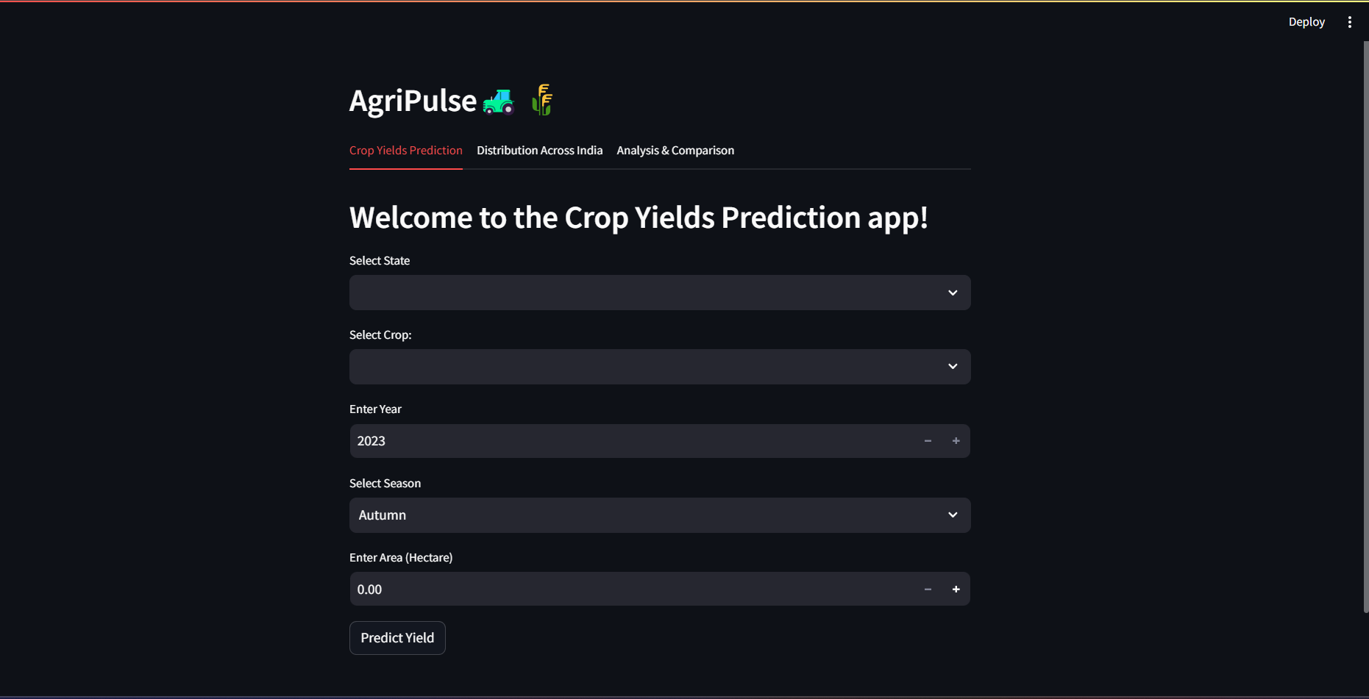
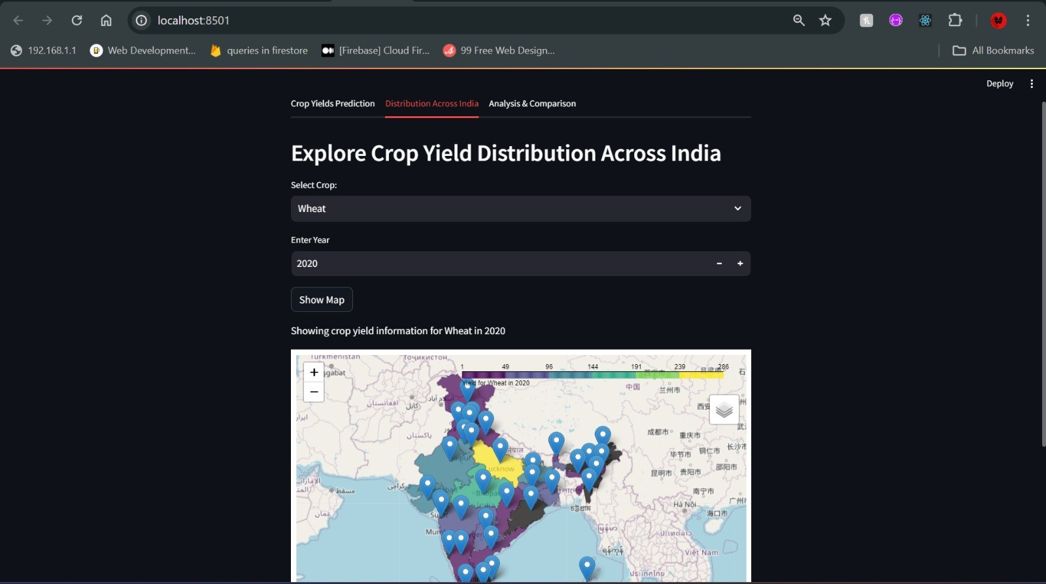
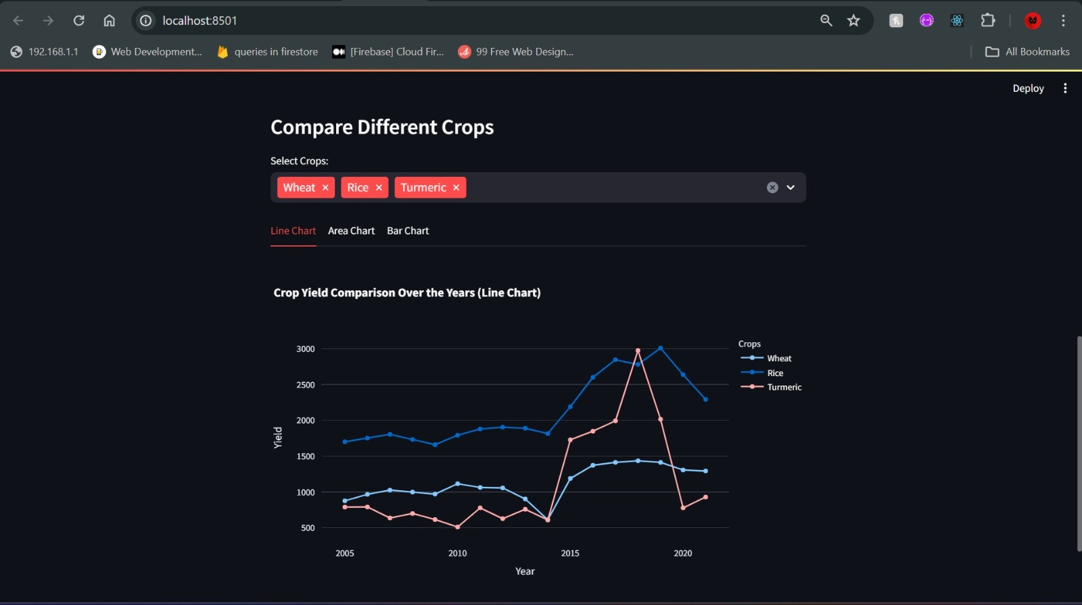
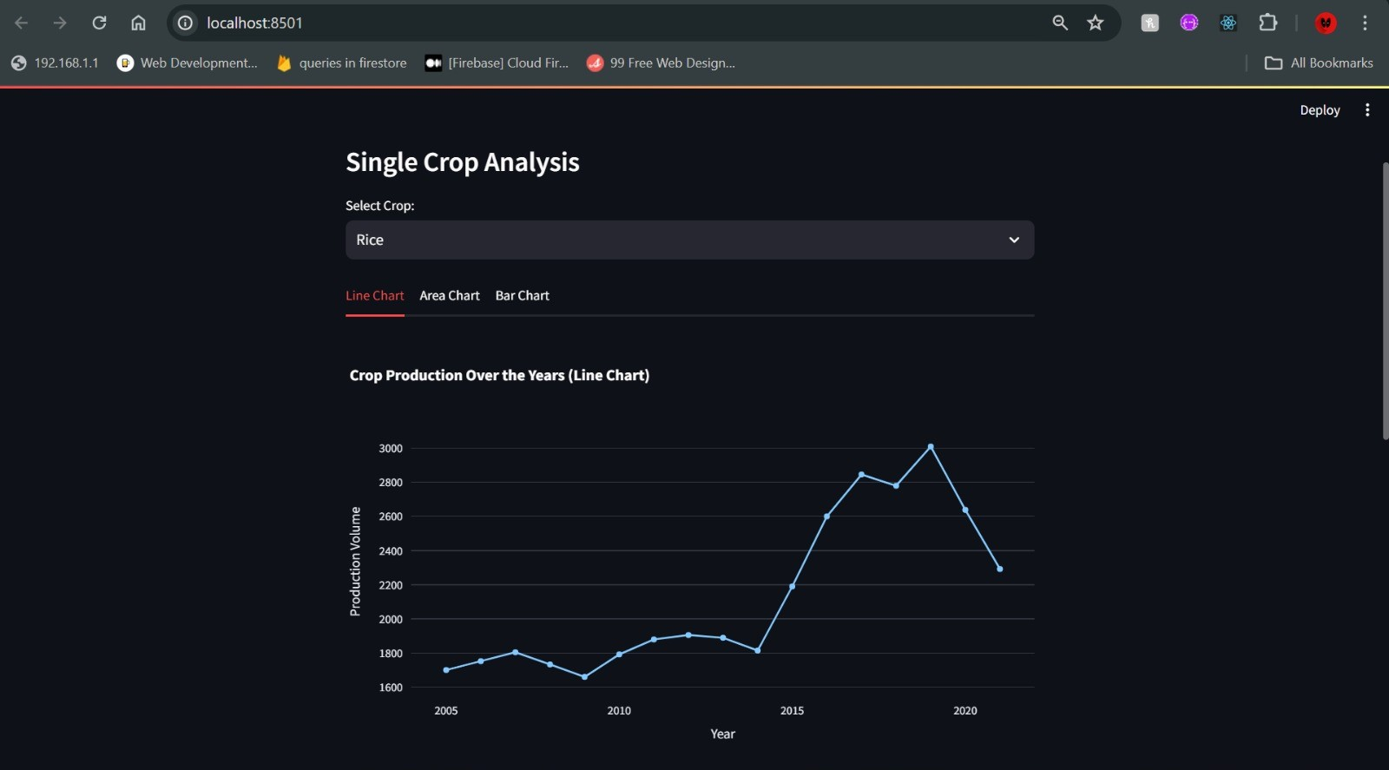
Model Deployment

Slide 12

Thank you!

